Slide 1
SMARTINTERNZ
Smart Agriculture Based On IoT
By: Soni Salgar

Slide 2
Overview
What is Smart Agriculture?
Category: IoT Based
Skills Required
Basic Requirements
Project Flow
Software Designing
Advantages & Disadvantages of Smart Agriculture based on IoT

Slide 3
What Is Smart Agriculture
Smart Agriculture is a farming management concept using modern technology to increase the quantity and quality of agricultural products.
Farmers in the 21st century have access to GPS, soil scanning, data management, and Internet of Things technologies.

Slide 4
Category: IoT Based
IoT: Internet Of Things
In IoT-based smart agriculture, a system is built for monitoring the crop field with the help of sensors (light, humidity, temperature, soil moisture, etc.) and automating the irrigation system.
The farmers can monitor the field conditions from anywhere.

Slide 5
Skills Required
IOT Application Development
IOT Cloud Platform
Programming language- Python

Slide 6
Basic Requirements
IBM Cloud
IBM Device
IBM Watson IoT
IBM IoT Simulator
Node.js
Node-RED
Python 3.8
Open Weather API platform

Slide 7
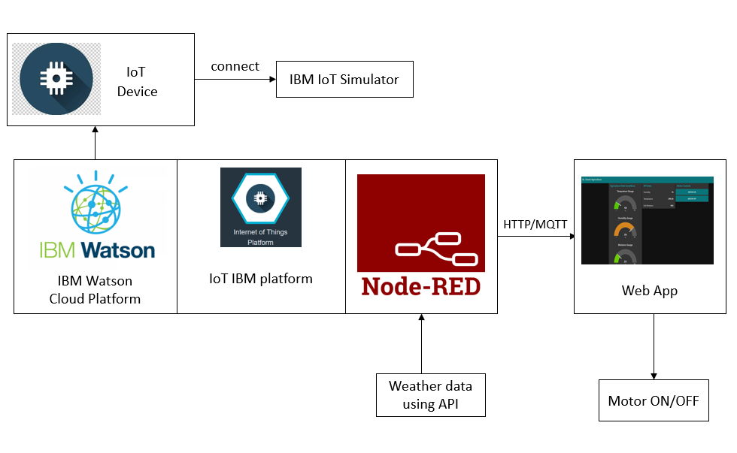
Project Flow

Slide 8
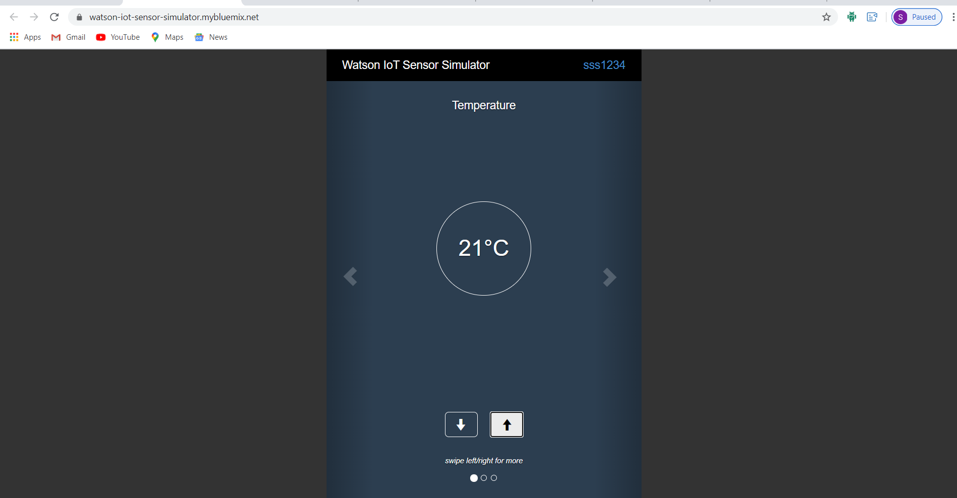
Software Designing
Fig (1)Watson IoT Simulator

Slide 9
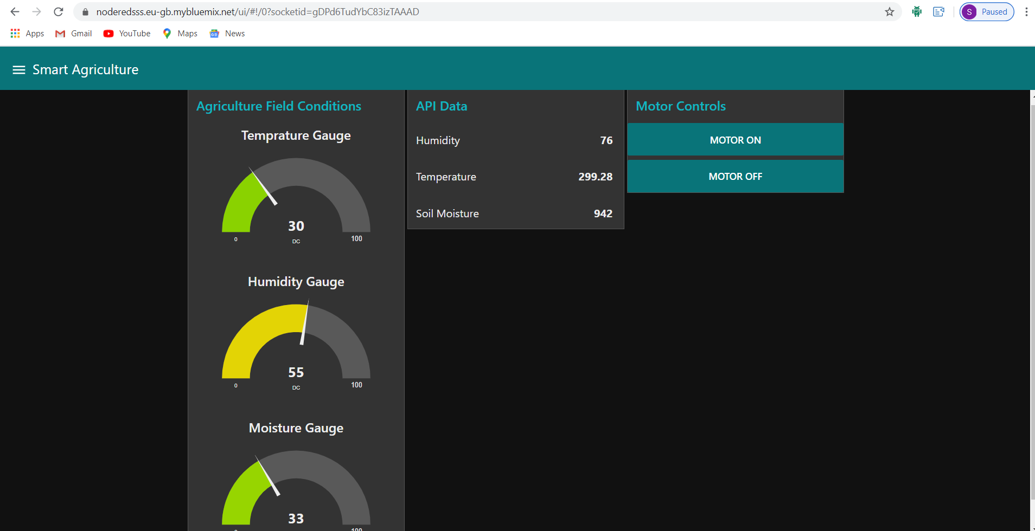
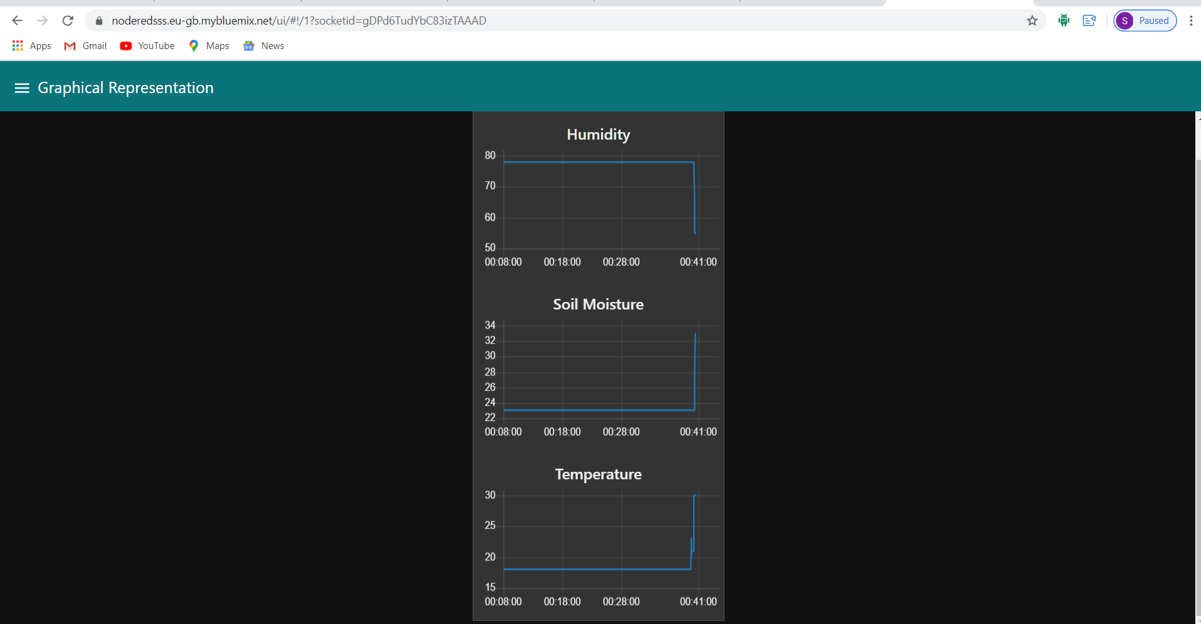
Fig (2)Web Application

Slide 10
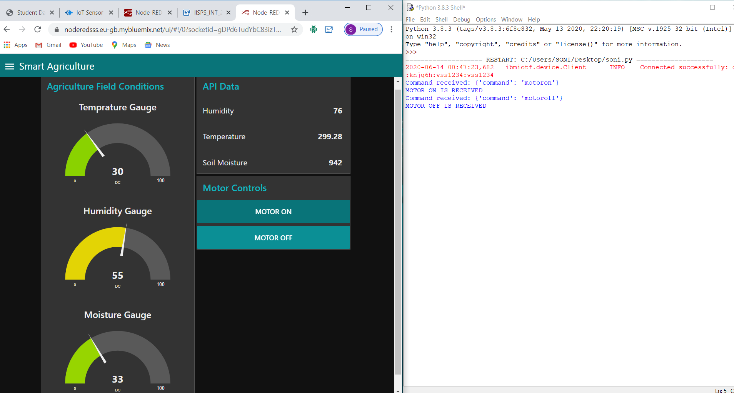
Fig(3) Device Control Action

Slide 11
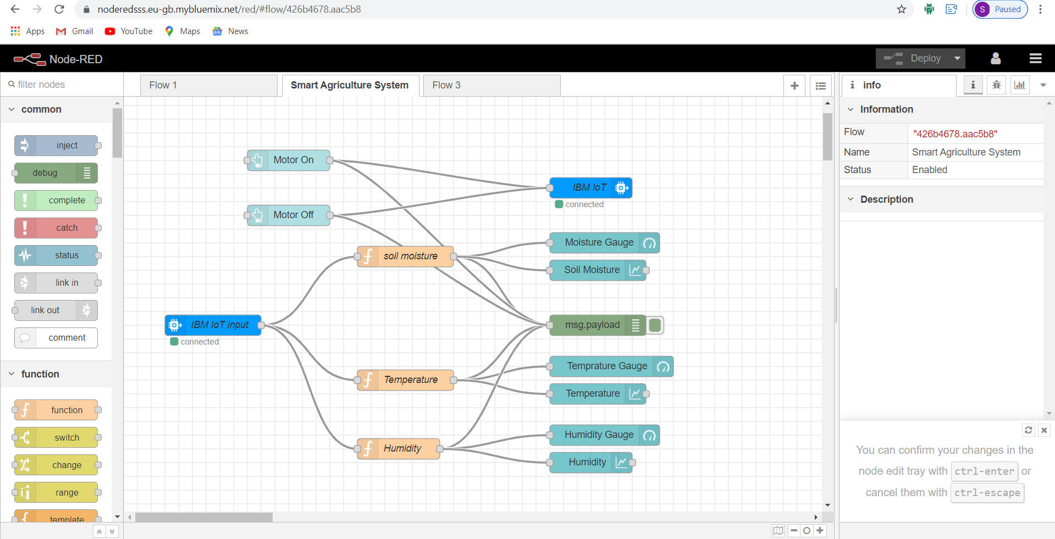
Fig(4)Node-RED flow

Slide 12
Advantages & Disadvantages of Smart Agriculture based on IoT
Advantages All the data like climatic conditions and changes in them, soil or crop conditions everything can be easily monitored . Risk of crop damage can be lowered to a greater extent.
Disadvantages Smart Agriculture requires internet connectivity continuously, but rural parts can not fulfill this requirement. Any faults in the sensors can cause great loss in the agriculture, due to wrong records and the actions of automated processes. IoT devices need much money to implement.

Slide 13
Thank You

